Slide 1
  Topic Modelling in Natural Language Processing

Slide 2
What is Topic Modeling?
  Topic modeling is a natural language processing (NLP) technique that uses unsupervised learning to identify topics within a collection of documents.
  Topic modeling is recognizing the words from the topics present in the document or the corpus of data.
  Topic modeling is a frequently used approach to discover hidden semantic patterns portrayed by a text corpus and automatically identify topics that exist inside it.

Slide 3
How topic modeling works?
Input: A large set of text documents (e.g., articles, reviews, or social media posts).
Output: A set of "topics," each represented by a group of words that frequently occur together and represent a coherent theme.
For example:
Topic 1: ["sports", "game", "team", "score", "match"]
Topic 2: ["recipe", "cook", "ingredients", "bake", "kitchen"]
The documents are then associated with these topics based on their word content.

Slide 4
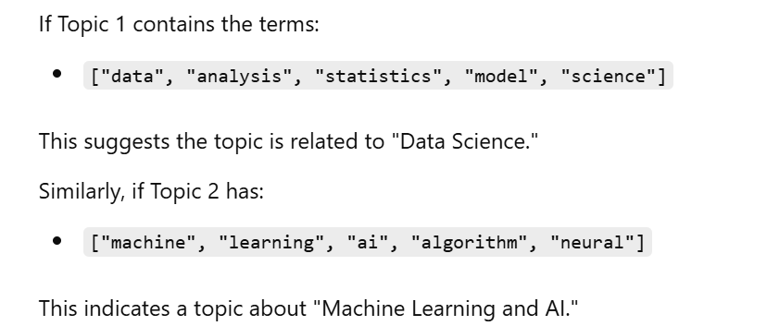
Topic Modeling Example

Slide 5
How topic modeling works?
  As an unsupervised learning method, topic models do not require user-generated labels of training data, as in supervised text classification tasks.
  Rather, topic models generate, and by extension annotate, large collections of document with thematic information in the form of word groups known as topics.

Slide 6
Types of Topic modeling algorithms
  Latent Dirichlet Allocation(LDA):
  Latent Semantic Analysis (LSA).

Slide 7
How Topic Modeling is Implemented?
  Step 1. Data Preparation:
  Step 2: Creating Document-Term Matrix(DTM)
  Step 4 : Topic Modeling with LDA.
  Step 5: Examine the Topics.
  Step 5.1 : Get the most probable words for each topic:
  Step 5 .2 : Get the topic proportions for each document:
  Step 6: Interpret the Results.

